Slide 1


Slide 2
Introduction
Any project involves planning, scheduling and controlling a number of interrelated activities with use of limited resources, namely, men, machines, materials, money and time.
  The projects may be extremely large and complex such as construction of a housing , a highway, a shopping complex etc.
  introduction of new products and research and development projects.
It is required that managers must have a dynamic planning and scheduling system to produce the best possible results and also to react immediately to the changing conditions and make necessary changes in the plan and schedule.

Slide 3
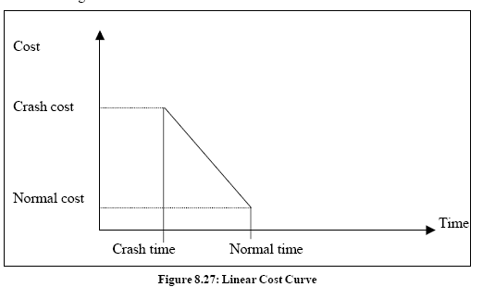
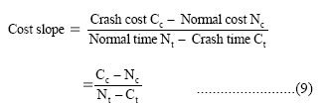
COST ANALYSIS
The two important components of any activity are the cost and time. Cost is directly proportional to time and vice versa.
For example, in constructing a shopping complex, the expected time of completion can be calculated using the time estimates of various activities. But if the construction has to be finished earlier, it requires additional cost to complete the project. We need to arrive at a time/cost trade-off between total cost of project and total time required to complete it.
Normal time:
Normal time is the time required to complete the activity at normal conditions and cost.
Crash time:
Crash time is the shortest possible activity time; crashing more than the normal time will increase the direct cost.
Cost Slope
Cost slope is the increase in cost per unit of time saved by crashing. A linear cost curve
is shown in Figure 8.27.

Slide 4


Example
An activity takes 4 days to complete at a normal cost of Rs. 500.00. If it is possible to complete the activity in 2 days with an additional cost of Rs. 700.00, what is the incremental cost of the activity?
Incremental Cost or Cost Slope
It means, if one day is reduced we have to spend Rs. 100/- extra per day.
Project Crashing
Procedure for crashing
Step1: Draw the network diagram and mark the Normal time and Crash time.
Step2: Calculate TE and TL for all the activities.
Step3: Find the critical path and other paths.
Step 4: Find the slope for all activities and rank them in ascending order.

Slide 5
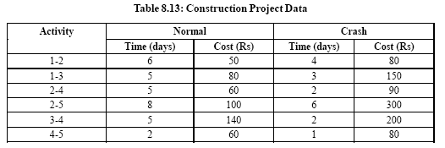
Step 5: Establish a tabular column with required field.
Step 6: Select the lowest ranked activity; check whether it is a critical activity. If
so,crash the activity, else go to the next highest ranked activity.
Note: The critical path must remain critical while crashing.
Step 7: Calculate the total cost of project for each crashing
Step 8: Repeat Step 6 until all the activities in the critical path are fully
crashed.
Example
The following Table 8.13 gives the activities of a construction project and other data.
If the indirect cost is Rs. 20 per day, crash the activities to find the minimum duration of the project and the project cost associated.

Slide 6
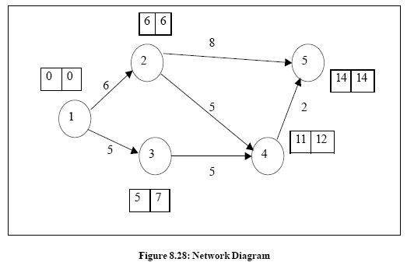
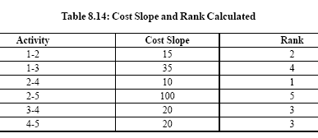


Solution
From the data provided in the table, draw the network diagram (Figure 8.28)
and find the critical path.
From the diagram, we observe that the critical path is 1-2-5 with project duration of
14 days
The cost slope for all activities and their rank is calculated as shown in Table 8.14

Slide 7
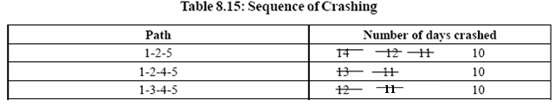
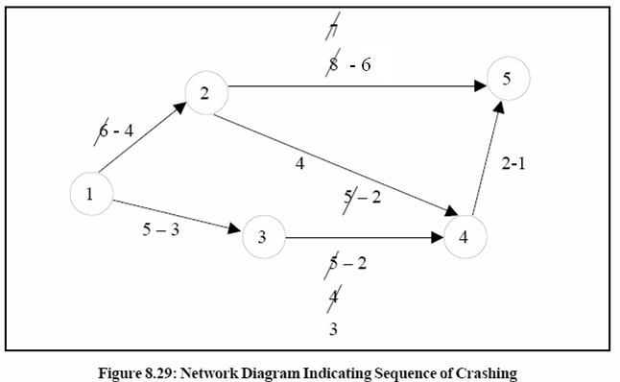
The available paths of the network are listed down in Table 8.15 indicating the sequence of crashing (see Figure 8.29).
The sequence of crashing and the total cost involved is given in Table 8.16 Initial direct cost = sum of all normal costs given
= Rs. 490.00

Slide 8
Activity Crashed | Project Duration | Critical Path | Direct Cost in (Rs.) | Indirect Cost in (Rs.) | Total Cost in (Rs.)
- | 14 | 1-2-5 | 490 | 14 x 20 = 280 | 770
1 – 2(2) 2 – 5(2) 2 – 4(1) 3 – 4(2) | 10 | 1 – 2 – 5 1 – 3 – 4 – 5 1 – 2 – 4 – 5 | 490 + (2 x 15) + (2 x 100) + (1 x 10) + (2 x 20) = 770 | 10 x 20 = 200 | 970
It is not possible to crash more than 10 days, as all the activities in the critical path are fully crashed. Hence the minimum project duration is 10 days with the total cost of Rs. 970.00.

Slide 9
Act. Imed. Pred. Time
Crash the project by 4 days
A None 7
B A 3
C A 4
D B,C 5
E D 2
F D 4
G E,F 5
B(3)
F(4)
G(5)
A(7)
D(5)
E(2)
C(4)

Slide 10
Time – Cost Analysis
Crashing the Project (Crash 4 days)
Activity | Normal Time | Crash Time | Normal Cost | Crash Cost | Cost/Day
A | 7 | 6 | $7,000 | $8,000 | $1,000
B | 3 | 2 | 5,000 | 7,000 | 2,000
C | 4 | 3 | 9,000 | 10,200 | 1,200
D | 5 | 4 | 3,000 | 4,500 | 1,500
E | 2 | 1 | 2,000 | 3,000 | 1,000
F | 4 | 2 | 4,000 | 7,000 | 1,500
G | 5 | 4 | 5,000 | 8,000 | 3,000

Slide 11
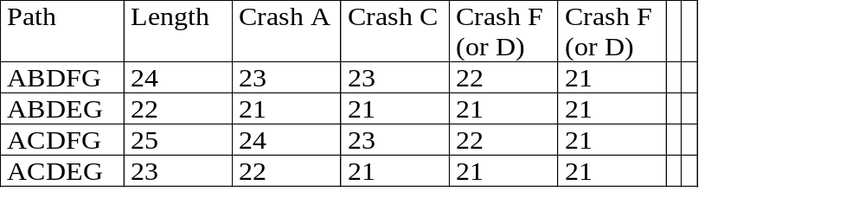
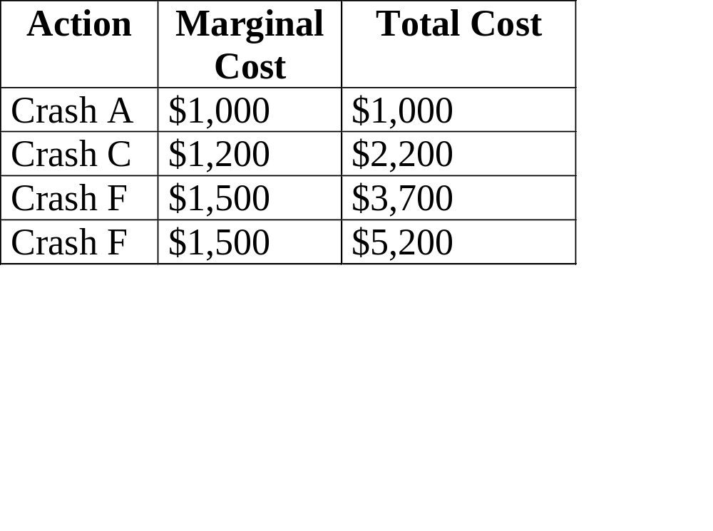
Action

Slide 12
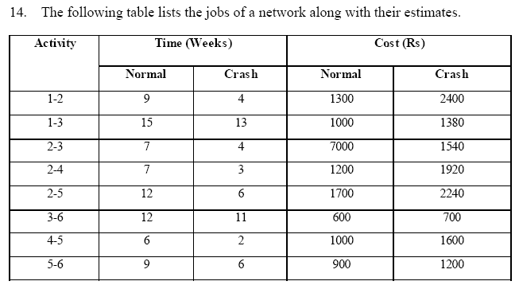
a. Draw the project network diagram.
b. Calculate the length and variance of the critical path.
c. What is the probability that the jobs on the critical path can be
completed in 41 days?

